Slide 1
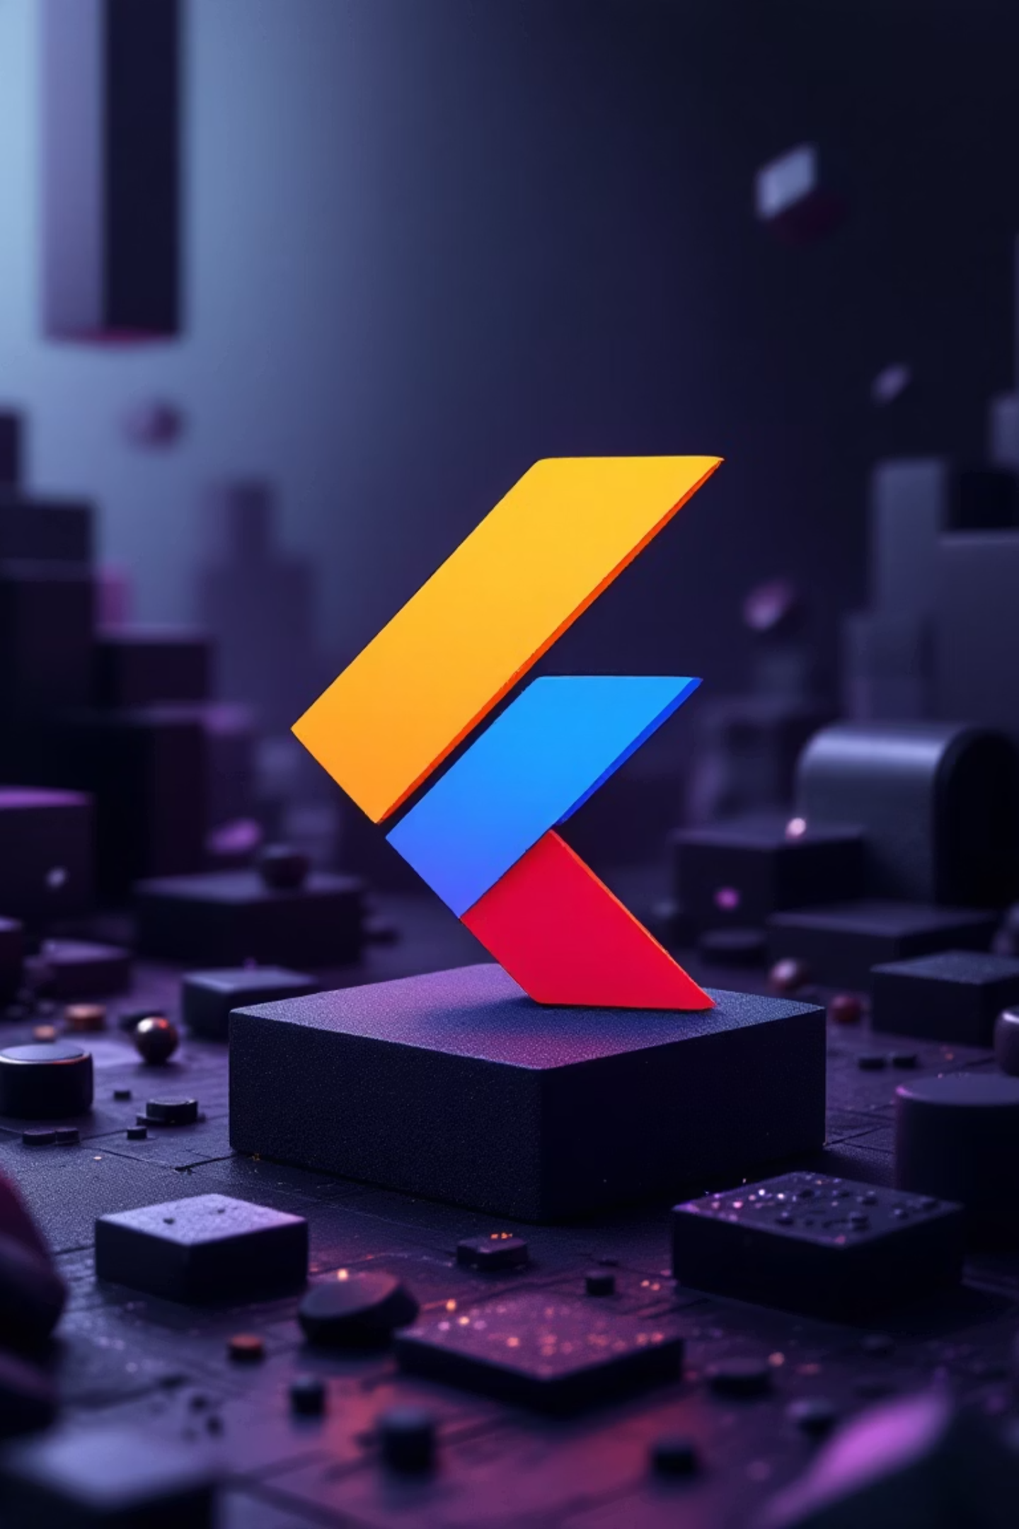
Essential Flutter Widgets
Unlock the power of Flutter development by mastering its fundamental building blocks. This presentation will guide you through core widgets for layout, input, display, and more, empowering you to create beautiful and responsive mobile applications.

Slide 2
The Foundation: Container, Padding & Decoration
Container: Your All-in-One Box
Padding: Internal Spacing
DecoratedBox & BoxDecoration: Visual Flourishes
The Container widget is highly versatile, allowing you to define width, height, margin, and padding for its child. It's perfect for applying aesthetic properties like colors, decorations, and precise alignment, serving as a powerful building block for complex UI elements.
Padding is crucial for controlling the space inside a widget. It ensures your content breathes and isn't cramped against edges, improving readability and visual appeal. Define uniform or asymmetric spacing with ease.
For rich visual styling like backgrounds, intricate borders, and smooth gradients, combine DecoratedBox with BoxDecoration. This powerful duo transforms simple widgets into polished, visually engaging components.
Padding(padding: EdgeInsets.all(16))
Container(width: 100, height: 50, color: Colors.blue)
DecoratedBox(decoration: BoxDecoration(color: Colors.blue, borderRadius: BorderRadius.circular(12)))

Slide 3
Arranging Elements: Column, Row, & Flex Widgets
Flutter's layout widgets provide powerful tools for arranging children on the screen, creating responsive and adaptive designs.
1
2
Column & Row: Vertical and Horizontal Alignment
Center: Effortless Centering
Column stacks widgets vertically, while Row arranges them horizontally. They are the backbone of most Flutter layouts, offering control over alignment and spacing for their children.
The Center widget makes it simple to center its single child within the available space. Ideal for aligning content perfectly in the middle of a screen or parent widget.
3
4
Expanded: Filling Available Space
Flexible: Adaptable Sizing
Within a Row or Column, Expanded forces its child to fill any remaining space. This is essential for creating responsive layouts where elements adapt to different screen sizes.
Flexible allows a child to occupy a flexible portion of space within a Row or Column, similar to Expanded, but it also permits the child to shrink if needed, preventing overflow issues.

Slide 4
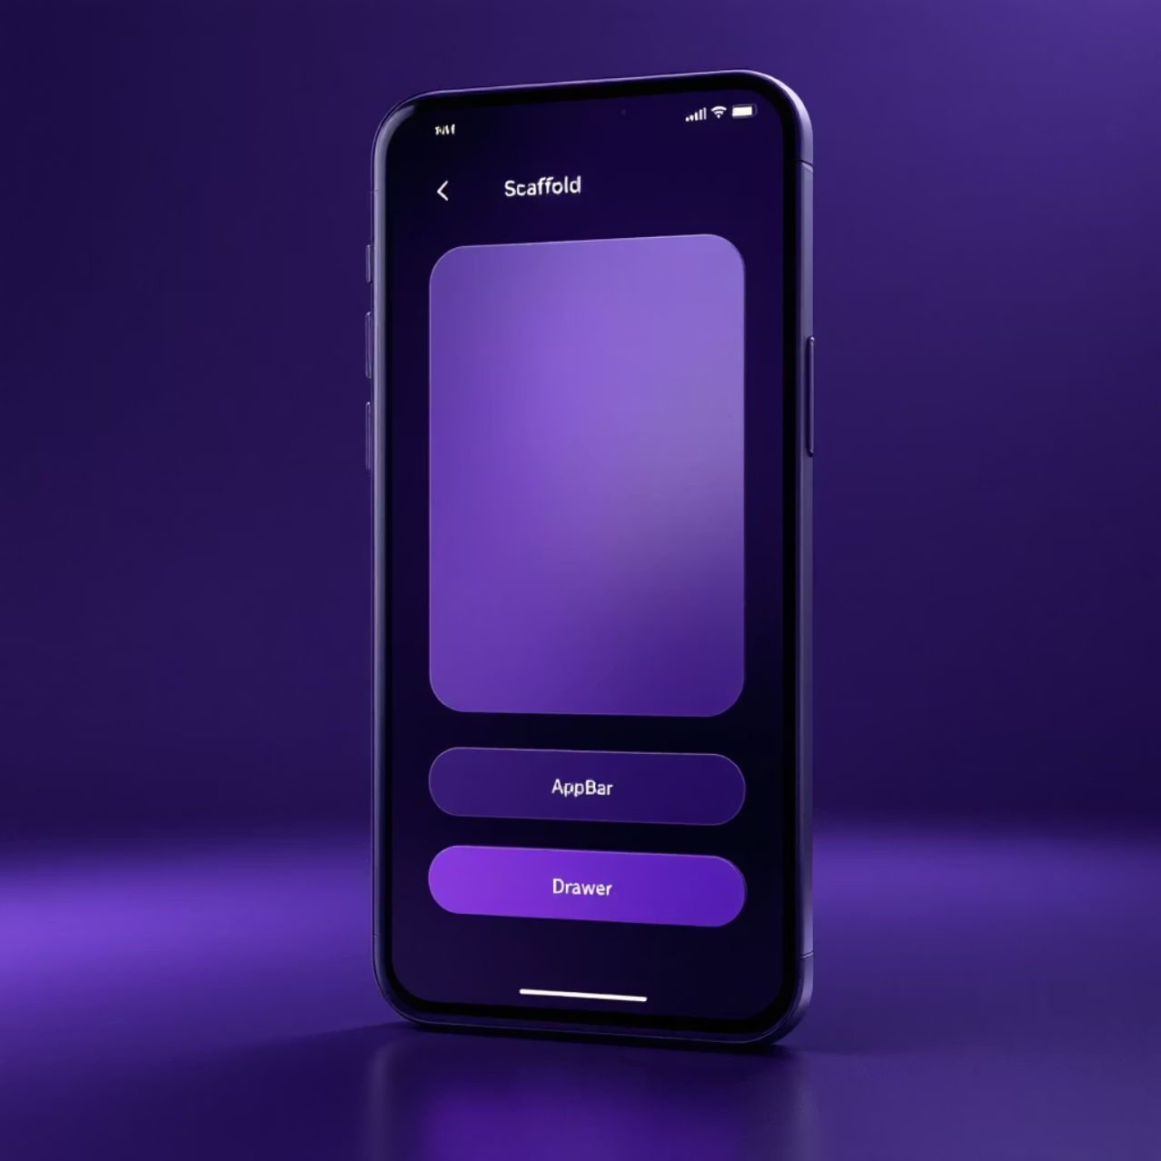
Scaffold: The Blueprint for Your App Screen
The Scaffold widget provides a basic visual structure for your app, implementing the material design layout structure. It's the starting point for most screens, offering common UI elements pre-configured for consistency.
AppBar: The top-most bar, typically containing the title, actions, and leading widgets.
Body: The primary content of the screen, filling the available space below the AppBar.
FloatingActionButton: A prominent circular button often used for the primary action on a screen.
Drawer: A panel that slides out from the side, typically for navigation links.
BottomNavigationBar: A horizontal bar at the bottom of the screen for quick navigation between top-level views.
Scaffold(appBar: AppBar(title: Text("Home")), body: ...)

Slide 5
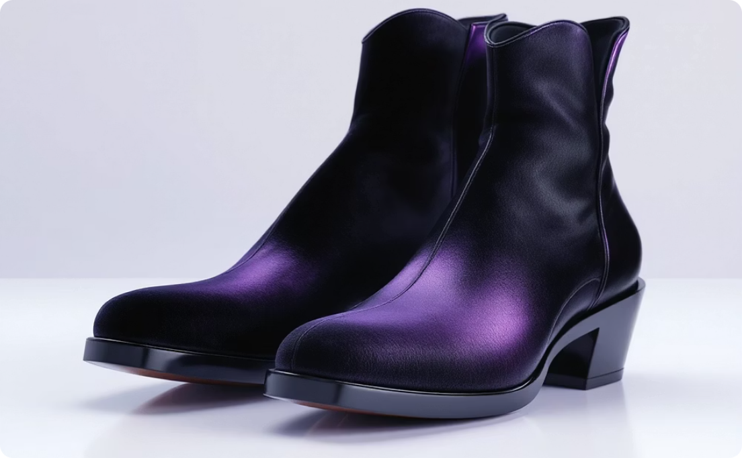
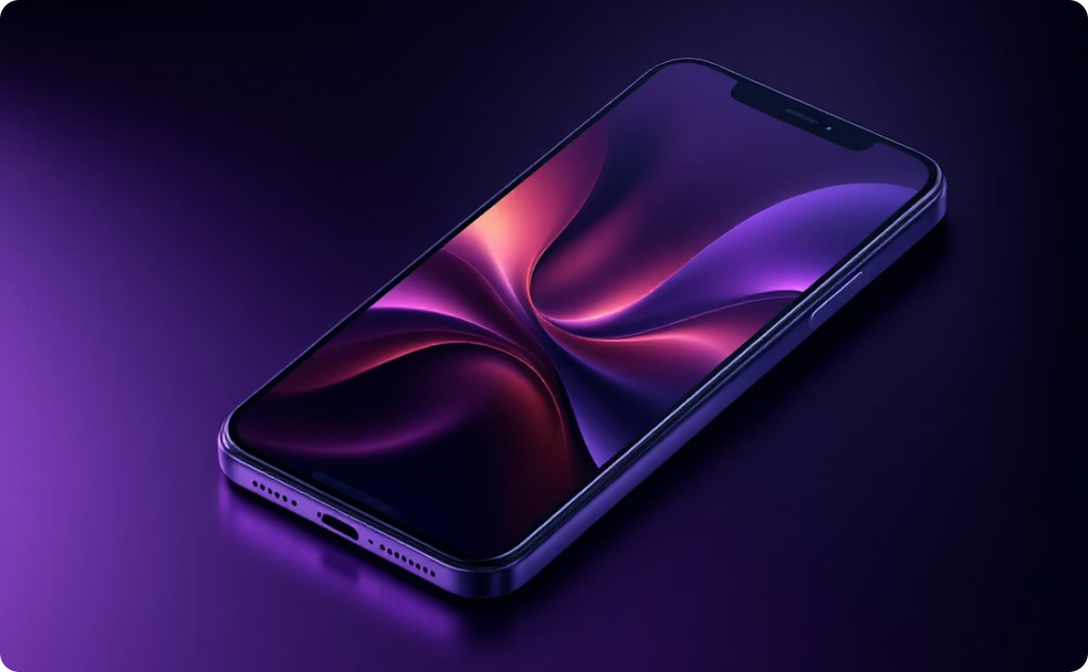
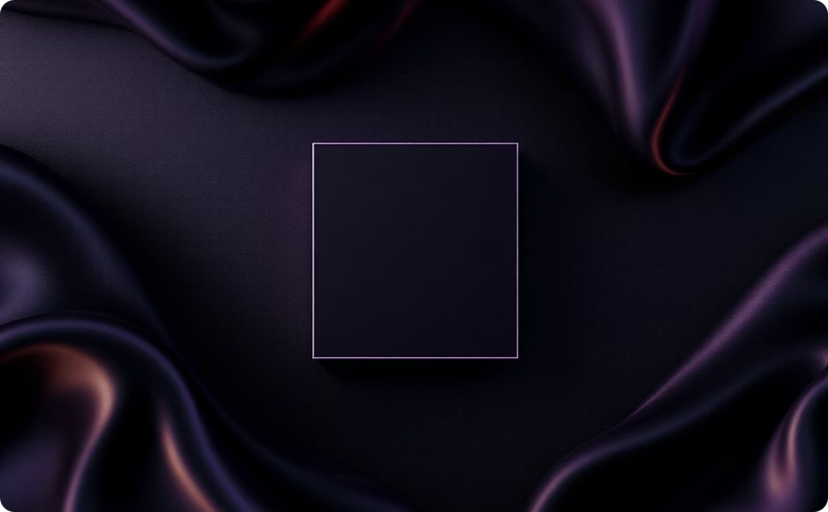
Displaying Content: Text, Image, & SizedBox
These fundamental widgets are essential for presenting information and managing spacing within your Flutter applications.
Text: Styling Your Words
Image: Visual Storytelling
SizedBox: Precise Spacing Control
The Text widget displays a string of text. You can fully customize its appearance with various properties like font size, weight, and color to match your app's design language.
The Image widget allows you to display graphics from various sources. Use Image.asset for local images bundled with your app, and Image.network for images loaded from the internet.
The SizedBox widget creates a box with a specified width and/or height. It's invaluable for adding fixed spacing between other widgets, ensuring consistent layout and visual separation.
Text("Hello", style: TextStyle(fontSize: 20))
Image.asset("assets/logo.png")
SizedBox(height: 20)

Slide 6
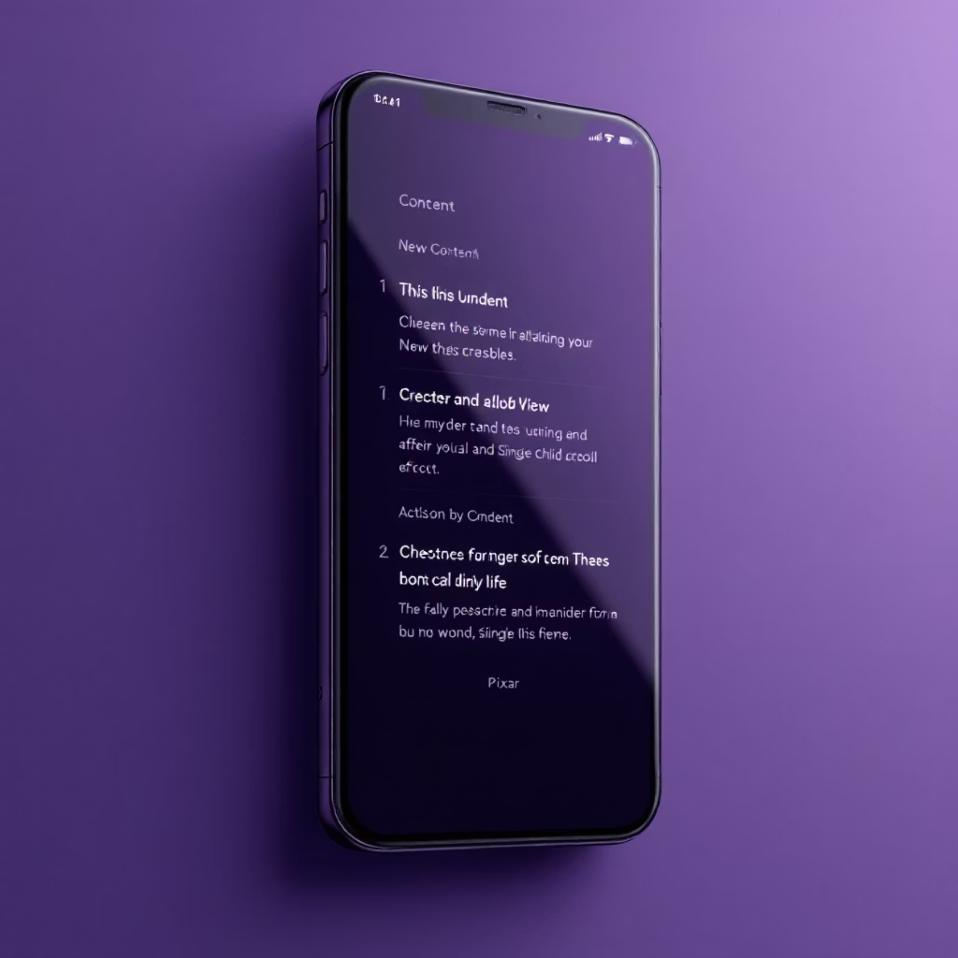
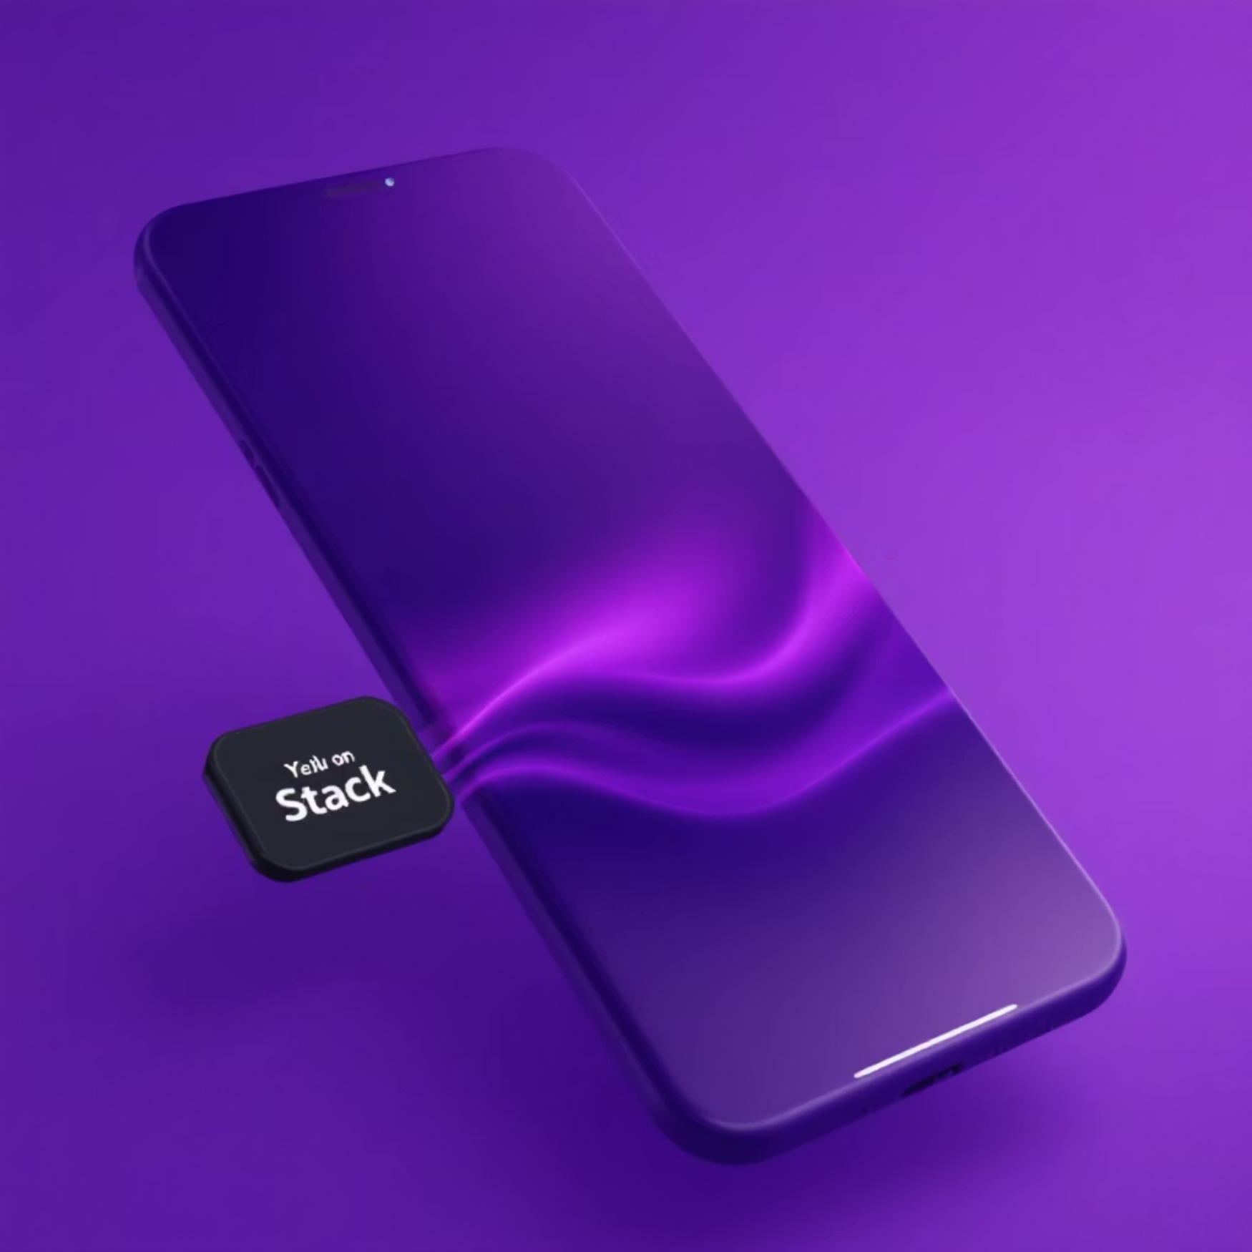
Dynamic Layouts: SingleChildScrollView & Stack
SingleChildScrollView: Making Content Scrollable
Stack: Layering Widgets
When content exceeds the screen's bounds, SingleChildScrollView comes to the rescue. It allows its single child to scroll, preventing overflow errors and ensuring all content is accessible, whether vertically or horizontally.
The Stack widget allows you to overlap multiple widgets, positioning them relative to the edges of the box. This is incredibly useful for creating complex overlays, badges, or custom layout arrangements where elements need to sit on top of each other.
SingleChildScrollView(child: Column(...))
Stack(children: [Image.asset("bg.png"), Positioned(top: 10, right: 10, child: Text("Badge"))])

Slide 7
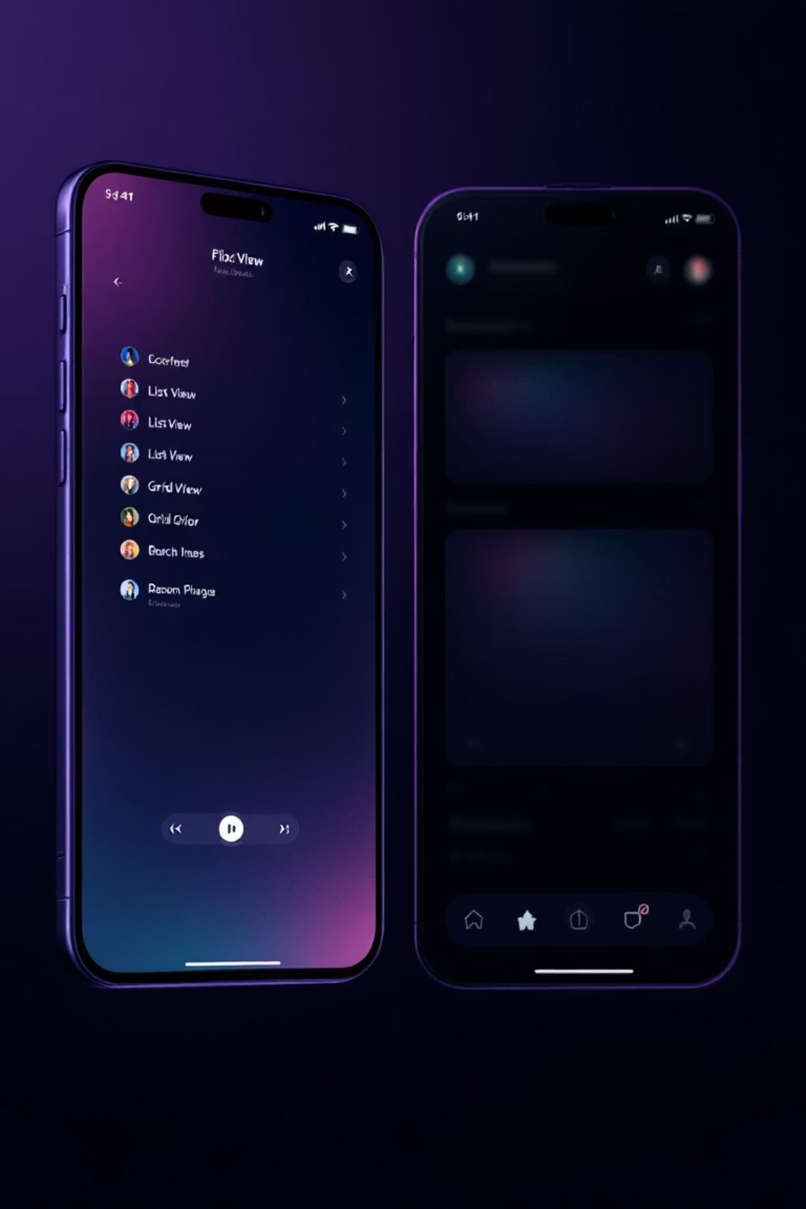
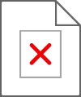
Efficient Lists: ListView & GridView
For displaying collections of items, Flutter provides highly optimized scrollable list and grid widgets, crucial for performance in data-rich applications.
ListView: Scrollable Item Lists
The ListView widget is perfect for displaying a scrollable, linear list of widgets. For lists with many items, use ListView.builder for performance gains, as it only builds items that are currently visible on screen.
ListView.builder(itemBuilder: (context, index) { ... })
GridView: Organize in Grids
GridView displays widgets in a two-dimensional scrollable array. Use GridView.count for a fixed number of columns or GridView.builder for more dynamic, performant grid creation, especially with large datasets.
GridView.count(crossAxisCount: 2, children: [...])

Slide 8
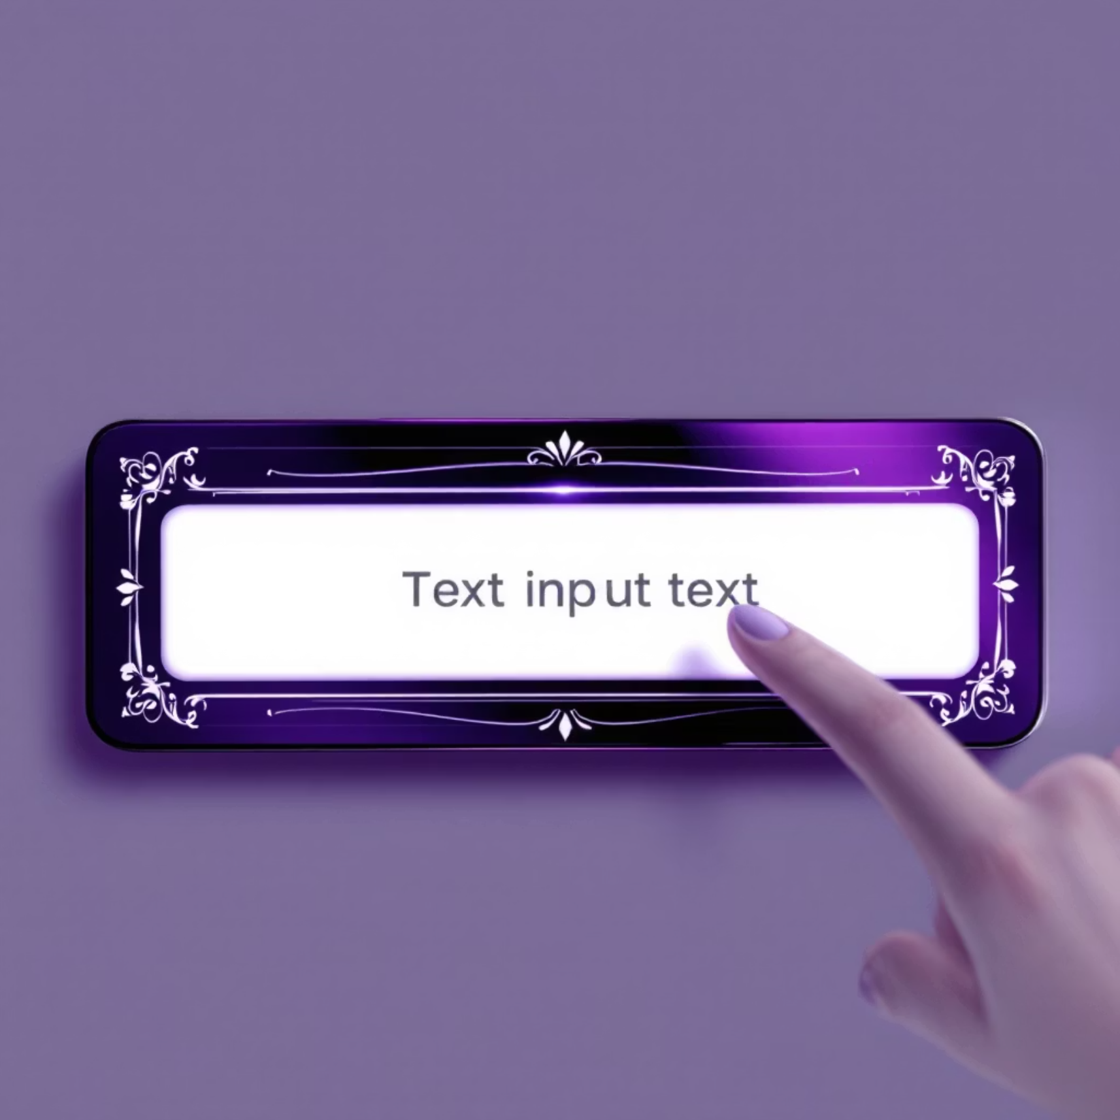
User Interaction: TextField
The TextField widget is Flutter's primary input component, allowing users to type text, numbers, and other data into your application. It's highly customizable and crucial for forms and interactive elements.
Controllers: Manage the text content programmatically.
Validation: Implement logic to ensure user input meets specific criteria.
Decoration: Customize the visual appearance with labels, hints, borders, and icons.
Keyboard Types: Specify the type of keyboard (e.g., numeric, email) to optimize user experience.
TextField(controller: nameCtrl, decoration: InputDecoration(labelText: "Name", border: OutlineInputBorder()))

Slide 9

Action & Navigation: ElevatedButton & TextButton
Buttons are fundamental for user interaction, allowing them to trigger actions and navigate within your app. Flutter provides distinct styles to suit different design needs.
ElevatedButton: Prominent Actions
TextButton: Subtle Interactions
ElevatedButton is a Material Design button with a raised appearance, indicating a primary action. It lifts off the surface, providing a visual hierarchy that draws attention to important interactions.
TextButton (formerly FlatButton) offers a minimalist design without elevation, ideal for less prominent actions, secondary options, or inline text links. It focuses on the text content for clarity.
ElevatedButton(onPressed: (){}, child: Text("Submit"))
TextButton(onPressed: (){}, child: Text("Cancel"))

Slide 10
Control & Selection: Checkbox, Radio, Switch
These interactive widgets allow users to make choices and control settings within your application, enhancing usability and customization.
Checkbox: Multi-Selection Options
Radio: Exclusive Choices
Switch: ON/OFF Toggles
Radio buttons are used when users must choose exactly one option from a mutually exclusive set. Selecting one radio button automatically deselects any others in the same group.
A Switch widget provides a clear way for users to toggle a single setting between two states, typically "ON" and "OFF". It's ideal for immediate activation or deactivation of features.
A Checkbox allows users to select one or more options from a list. It's suitable for settings where multiple preferences can be active simultaneously.
Checkbox(value: isChecked, onChanged: (bool? val) { ... })
Radio(value: 'A', groupValue: _selection, onChanged: (String? val) { ... })
Switch(value: isOn, onChanged: (bool val) { ... })

